Slide 1
Schelling Segregation Model with Statistical Mechanics of Opinion Formation

Slide 2
Model Summary
Basic Schelling Model
Plus:
overlaid with a preferential attachment network (Barabasi and Albert 1999)
opinions of neighborhood preference spread through statistical mechanics of opinion formation (Bahr and Passerini 1998)
Neighborhood preference can be either:
Schelling type (don’t want to be in strictest minority), or
don’t care

Slide 3
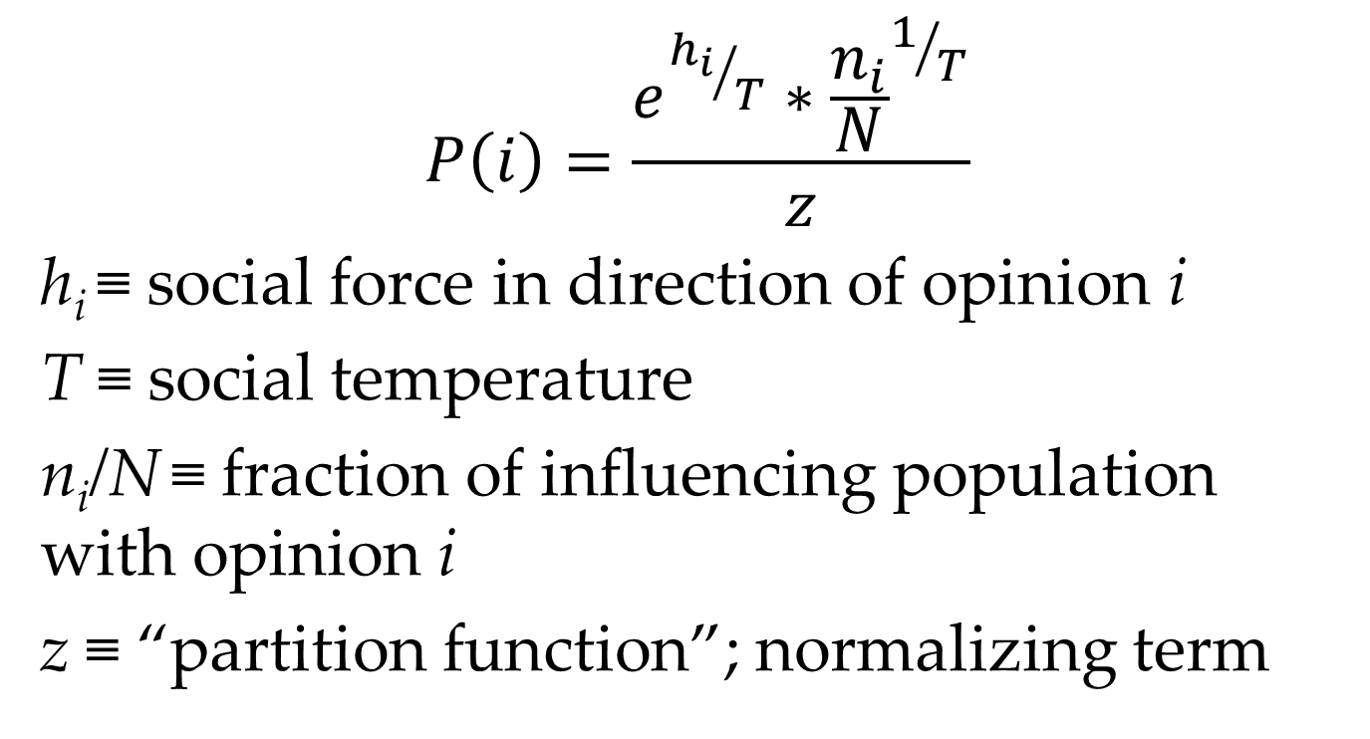
Statistical Mechanics of Opinion Formation
$$P\left(i\right)=\frac{e^{{h_{i}}/T}∗{\frac{n_{i}}{N}}^{1/T}}{z}$$
h_{i} ≡ social force in direction of opinion i
T ≡ social temperature
n_{i}/N ≡ fraction of influencing population with opinion i
z ≡ “partition function”; normalizing term

Slide 4
Overview
Initialize agent
Generate network edges
Place randomly in world
repeat 1 – 3 for N agents
Cycle through all agents until change in happiness < ε :
evaluate agent opinion state
evaluate agent happiness
move agent if unhappy (or otherwise time to move)

Slide 5
Agent Attributes
Attribute | Description | Initialization
race | number; immutable | 0 for ½ population, 1 for the other ½
opinion | whether agents have a neighborhood preference or not | α : Schelling 1-α : No preference
friends | instantiates the network | [self]

